Slide 1
Pretrial, Probation, and Post-Release: Compare and Contrast
August 13, 2024
Notes:
Troy
Welcome to Pretrial, Probation, and Post-Release Practices: Compare and Contrast.

Slide 2
Notes:
Troy
Funding for this presentation is provided by the U.S. Department of Justice, Bureau of Justice Assistance (BJA) through its Community Supervision Resource Center (CSRC), which is operated by the Center for Effective Public Policy (CEPP).
The Bureau of Justice Assistance is a component of the Department of Justice's Office of Justice Programs, which also includes the Bureau of Justice Statistics, the National Institute of Justice, the Office of Juvenile Justice and Delinquency Prevention, the Office for Victims of Crime, and the SMART Office. Points of view or opinions in this document are those of the author and do not necessarily represent the official position or policies of the U.S. Department of Justice.

Slide 3
CSRC Project Partners
Notes:
Troy
Ensure CSRC work includes: Racial Equity, Gender-informed approaches. Special populations and Voices of impacted people and communities
Provide leadership and guidance toward each of CSRC’s main components: Website, Resources, Training, Technical Assistance, Racial Equity

Slide 4
Community Supervision Resource Center (CSRC)
CSRC
Website
Resource Library
Technical Assistance
Training
Online Peer Learning Community
ISI (Smart Supervision) Sites
Notes:
Troy

Slide 5
Faculty
Tanya Anderson
Associate Director
Center for Effective Public Policy
Denise Symdon
Senior Manager
Center for Effective Public Policy
Michael Beltran
Justice Policy Consultant
Notes:
Each will introduce themselves starting with Tanya

Slide 6
Training Objectives
Discuss
Discuss the definitions and legal foundation for pretrial, probation, and post-release supervision.
Review
Review similarities and differences.
Gain
Gain an understanding of best practices that promote success.
Learn
Learn the importance of measuring success.
Notes:
Tanya
Read this slide

Slide 7
Getting to Know You
What role do you serve in your respective jurisdiction?
Case Manager
Court Administrator
Judicial Officer
Pretrial Director/Manager/Supervisor
Pretrial Officer
Probation Officer
TA Provider
Other
Notes:
Tanya-Poll Question
But more than that, we would like to know who is in our audience based on the role you serve.
1. What role do you serve in your respective jurisdiction?
Case Manager
Court Administrator
Judicial Officer
Pretrial Director/Manager/Supervisor
Pretrial Officer
Probation Officer
TA Provider
Other

Slide 8
Language Matters
Strength-based
People-centered
Human Dignity
Equity-focused
https://communitysupervisioncenter.org/wp-content/uploads/2024/06/CSRC-Language-Guide.pdf
Notes:
Tanya
** Don’t forget XXX**
We believe language—the words we use in written and verbal communications— plays a role in gaining support for system advancements and contributes to meaningful and lasting culture change. Your language matters! Because your language helps shape your thinking, which affects your decisions and the actions you take regarding people affected by the criminal legal system. Research shows that language and framing can reinforce stereotypes. So , we support the deliberate use of language that is strength-based, people-centered, inclusive, and equity-focused to maintain the human dignity of people we work with.

Slide 9
Language Matters
Avoid… | Instead, use…
Criminal, convict | Person convicted of a crime
Defendant | Person Person charged with/accused of a crime Person arrested/charged/accused
Ex-offender, ex-con, ex-inmate | Person who was system-involved Person with prior criminal justice system involvement Person who was incarcerated Person with lived experience Person reentering/rejoining the community Returning citizen
Felon | Person convicted of a felony
Inmate, prisoner, detainee | Person in jail/prison Person is incarcerated
https://communitysupervisioncenter.org/wp-content/uploads/2024/06/CSRC-Language-Guide.pdf
Notes:
Tanya
Throughout all of CSRC’s materials and resources, we strive to use terms that humanize people impacted by the criminal legal system. We frame ideas and concepts in the positive rather than the negative. Describing pretrial behavior in the negative (i.e., failure to appear, new arrest) perpetuates the misconception that pretrial failure is the rule rather than the exception. In fact, an overwhelming number of people are successful during the pretrial phase of the criminal legal system process.
This is process! It is not going to happen overnight.

Slide 10
Language Matters
Avoid… | Instead, use…
Misdemeanant | Person convicted of a misdemeanor
Nonviolent offender | Person convicted of a nonviolent offense
Offender, perpetrator | Person who committed an offense
Parolee, probationer | Person on parole/probation Person under judicial supervision
Violent offender | Person convicted of a violent offense Person who committed a violent offense
https://communitysupervisioncenter.org/wp-content/uploads/2024/06/CSRC-Language-Guide.pdf
Notes:
Tanya
Throughout all of CSRC’s materials and resources, we strive to use terms that humanize people impacted by the criminal legal system. We frame ideas and concepts in the positive rather than the negative. Describing pretrial behavior in the negative (i.e., failure to appear, new arrest) perpetuates the misconception that pretrial failure is the rule rather than the exception. In fact, an overwhelming number of people are successful during the pretrial phase of the criminal legal system process.
This is process! It is not going to happen overnight.
.

Slide 11
General Definitions for Pretrial, Probation and Post-Release Supervision
Compare and Contrast

Slide 12
Pretrial supervision is a condition of release ordered by a judicial officer for a person charged with an offense(s) while awaiting the final disposition of their case.
General Definitions for Pretrial Supervision
AUTHORITY
Judicial officer
STATUS
Charged, not convicted
PERIOD
While a case is pending final disposition
SUPERVISING BODY
Pretrial services staff person or agency
Notes:
Denise

Slide 13
General Definitions for Probation Supervision
Probation supervision is imposed by a judicial officer as a sentence, a condition of a suspended sentence, or in lieu of incarceration.
AUTHORITY
Judicial officer
STATUS
Convicted, imposed as part of a sentence, or in lieu of sentence
PERIOD
As determined by the judicial officer
SUPERVISING BODY
Court, county or state agency, or private company
Notes:
Denise
Probation supervision is imposed by a judicial officer as a sentence, a condition of a suspended sentence, or in lieu of incarceration.

Slide 14
General Definitions for Parole Supervision
Post-release supervision is commonly referred to as “supervised release.” This is a period of community supervision imposed by the court to be completed after release from a jail or prison sentence.
Parole is the release of a person from jail, prison, or other confinement by an administrative entity (e.g., parole board) after the person has served a portion of their sentence.
AUTHORITY
Judicial officer or parole board
STATUS
Convicted, post-release supervision after jail or prison
PERIOD
As determined by the judicial officer or parole board
SUPERVISING BODY
County or state agency
Notes:
Denise

Slide 15
Fundamental Similarities and Differences
Compare and Contract

Slide 16
Fundamental Similarity?
Notes:
Denise
Two part slide: Let's start with a question for the chat. “What do you think is the fundamental similarity between probation, pretrial, and post-release supervision?”
Next click:
First: work with people – this is a people business.
We all work to maximize community safety.
As such, we need to remember that in spite of what someone has been arrested, convicted, or sentenced for, they are people who deserve to be treated with humanity and respect.
Our work is to promote success and that should be reflected in how we do our work and interact with the those we work with.
We all offer supportive services, either in person through 1:1 appointments, or referrals to programs.
Second: both systems work with individuals who have been RELEASED INTO THE COMMUNITY WITH CONDITIONS with expectations outlined by the court or parole board.

Slide 17
Fundamental Difference?
Pre-Conviction
Post-Conviction
Notes:
Denise
Two part slide: So another question. Please list in the chat “What do you think is a fundamental difference between pretrial and probation”?
Click to this screen – Pretrial is pre-conviction and Probation/Post-Release Supervision are both Post-conviction.
These are big differences.

Slide 18
Goals or Purposes of Pretrial
Maximize pretrial release/liberty
Maximize court appearance
Maximize law-abiding behavior/community safety
Notes:
Tanya-
GOALS AND PURPOSES OF PRETRIAL AND PROBATION ARE VERY DIFFERENT
These goals are from the work of Tim Schnacke and the National Institute of Corrections. Known as the 3 M's.
At CSRC, we also refer to another goal that applies to all parts of the system: to maximize equity and ensure everyone has access to supportive services.
Equality and Equity are not the same! (equality is focused on treating everyone equally, but equity is understanding that individuals may need different resources to be successful and ensuring they have access to those resources)
We always want to focus on promoting success and not managing failure.

Slide 19
Goals or Purposes of Probation and Post-Release Supervision
Encourage and role model behavior change
Support rehabilitation
Ensure accountability
Enhance community well-being
Work to restore those harmed by crime
Foster successful outcomes
Facilitate access to targeted interventions
Notes:
Denise
These are minimum goals that probation and post-release supervision should work to accomplish.
These goals in general, are longer term than pretrial. Any of these that you don’t agree with?
Accountability – means a lot of different things to different people and stakeholders in the justice system, but the term should not equate to imposing punishment.

Slide 20
Compare and Contrast
Goals | Pretrial | Probation | Post-Release
Maximize pretrial liberty
Maximize court appearance
Maximize community safety
Offer supportive services
Promote successful outcomes
Encourage and model behavior change
Support rehabilitation
Restore those harmed by crime
Hold people convicted accountable
Refer to or provide targeted interventions
Support reintegration into the community
Satisfy the court sentence
Notes:
Tanya

Slide 21
History of Supervision and Conditions
Governing Laws and Background

Slide 22
Law: Right to Pretrial Release
The U.S. Supreme Court has held that the vast majority of people arrested are entitled to release before trial.
“In our society, liberty is the norm, and detention prior to trial or without trial is the carefully limited exception.”
Absent a right to pretrial release, “the presumption of innocence… would lose its meaning.”
U.S. v. Salerno, 281 U.S. 739 (1987)
Stack v. Boyle, 342 U.S. 1 (1951)
Notes:
Tanya
Talking points:
There are federal and state laws which reinforce that the vast majority of people have the right to pretrial release pending the disposition of their case.
At the federal level, two seminal Supreme Court cases set forth these guiding principles:
In U.S. v. Salerno, the Court said that, “In our society, liberty is the norm, and detention prior to trial or without trial is the carefully limited exception.”
After all, absent a right to pretrial release, “the presumption of innocence… would lose its meaning” (which the court said in Stack v. Boyle.)
The key point to remember is that PROBATION IS A PRIVILEGE WHILE PRETRIAL IS A RIGHT.

Slide 23
Law: Pretrial Release Conditions
Two main legal principles when setting conditions of release:
If any conditions are imposed, they must be the least restrictive necessary to provide reasonable assurance of court appearance and public safety
Conditions must be individualized.
U.S. v. Salerno, 281 U.S. 739 (1987)
Stack v. Boyle, 342 U.S. 1 (1951)
Notes:
Tanya
Talking points:
But some people may need assistance to help make sure they return to court and remain arrest-free.
There are two main legal principles that govern setting these conditions:
First, the Supreme Court tells us that any conditions imposed must be the least restrictive necessary. That means the least restrictive necessary to provide reasonable assurance of court appearance and public safety.
Second, before imposing release conditions, judicial officers must make individualized findings that such conditions are necessary.
So the bottom line is that pretrial release conditions must be deployed carefully, and not categorically. They should be determined on a case-by-case, individualized basis. And they must always be aimed at helping the person succeed while on pretrial release.

Slide 24
Laws Governing Probation
1878
Probation introduced in Massachusetts
1956
Adult probation established nationwide
Notes:
Denise
Massachusetts was the first state that introduced probation and by 1956, each state had some form of adult probation.
Each state is unique in how it carries out the authority of probation.
Probation practices are generally impacted by state statute, department policy, and local court rulings.
But, all states are impacted by: ABA standards and decisions rendered by the U.S. Supreme Court.
Griffin vs. Wisconsin is just one example of a state practice being impacted by the US Supreme Court.

Slide 25
Laws Governing Probation
Constitutionality of probation practices evolves through changes in:
State or Local Statutes and Court Rulings
American Bar Association (ABA) Standards
Supreme Court Decisions
Griffin vs. Wisconsin, the U.S. Supreme Court held that the warrantless search of a probationer's home in this case did not violate the Fourth Amendment (https://supreme.justia.com/cases/federal/us/483/868)
Notes:
Denise
Massachusetts was the first state that introduced probation and by 1956, each state had some form of adult probation.
Each state is unique in how it carries out the authority of probation.
Probation practices are generally impacted by state statute, department policy, and local court rulings.
But, all states are impacted by: ABA standards and decisions rendered by the U.S. Supreme Court.
Griffin vs. Wisconsin is just one example of a state practice being impacted by the US Supreme Court.

Slide 26
Example of Laws Governing Probation Conditions
The court has broad discretion to fashion appropriate conditions of probation in each individual case.
The validity of conditions of probation are tested by how well they serve the goals of rehabilitation and protection of the public.
State v. Simonetto, 2000 WI App 17, 232 Wis. 2d 315, 606 N.W.2d 275, 99-0486.
Notes:
Denise
Each state may promulgate rules and policies in a different way.
This is an example of language from WI of the broad discretion given to the courts to set appropriate probation conditions.
In WI, state statute directs how probation operates, and department policy is written based on language in state statutes.
Court rulings also inform what a probation agency does, including presentence investigations, supervision practices, and revocation proceedings.
At times, court decisions will change agency policies and procedures, which may in turn, require statutory language changes.
.

Slide 27
Evolution of Post-Release Supervision
States enacted parole statute
Parole systems used in all states and the federal system
Sixteen states abolished parole, favoring “determinate sentencing”
New York “good time law” passed
Massachusetts hired staff to assist prisoners with release
The first prison in the nation was constructed in Massachusetts
1817
1901
2018
1785
1845
1942
* US DOJ, Office of Justice Programshttps://www.ojp.gov/ncjrs/virtual-library/abstracts/history-and-concept-parole-corrections-community-alternatives
Notes:
Denise
First prison was likely about creating deterrence and removing people from their “bad” environments.
2018: Determinate sentencing may have been viewed as a means to diminish the discretion of the judiciary.

Slide 28
Post-Release Pathways
Incarcerated people leaving confinement onto parole do so via different post-release supervision pathways:
Parole supervision
Mandatory release
Supervised release
Notes:
Denise

Slide 29
Post-Release Pathways
All involve some period of supervision following release from prison governed and influenced by:
State or Local Statutes and Court Rulings
American Bar Association (ABA) Standards
Supreme Court Decisions
Notes:
Denise

Slide 30
Post-Release Supervision Conditions
Standard conditions of parole are imposed on all people returning to their community on post-release supervision and often include:
when to report
maintaining a known address
abiding by restrictions on movement and travel
payment of fees
Special conditions may be added by the court or administrative entity, such as a parole board.
Sometimes, the parole/supervising agent can also add special conditions.
“Supervision conditions” should be limited “to no more than required to achieve the objectives of supervision”. *
American Probation and Parole Association, 2017
Notes:
Denise
Recent changes to both probation and post-release supervision conditions stem from the broader framework surrounding evidence-based practices.
In 2017 APPA published the recommendation, based on research and best practices that conditions should be limited to no more than required to achieve the objectives of supervision.

Slide 31
Example Conditions
Questions to consider when determining conditions:
If for probation or post-release, ask: “Does this condition relate to the current offense, reduce recidivism, change long-term behavior, or promote rehabilitation?”
If for pretrial, ask: “Does this condition help improve court appearance and reasonably ensure law-abiding behavior?”
Notes:
Tanya: Elevate JPC Voice
Regardless of your position in the legal system, if you are responsible for setting conditions, these are questions you should consider:
For probation: Does this condition contribute to reducing recidivism, target long-term behavior change, or promote rehabilitation?
For pretrial: Does this condition help improve court appearance and reasonably ensure law-abiding behavior?
Conditions should be as least restrictive as possible while ensuring success.
Remember, pretrial and probation are not a punishment.
Things you should consider when setting conditions are the offense, risk level, and individual criminogenic needs.
JPC: What was your experience with conditions?
Tanya
Comment on drug testing.

Slide 32
Example Conditions
Pretrial
Probation/Post Release
Court date notifications
Check-ins
Criminal history check
Offer supportive services referral
Check-ins
Referral for services
Drug/alcohol testing
Home visits
Additional conditions ordered by the officer
Notes:
Tanya: Elevate JPC Voice
Regardless of your position in the legal system, if you are responsible for setting conditions, these are questions you should consider:
For probation: Does this condition contribute to reducing recidivism, target long-term behavior change, or promote rehabilitation?
For pretrial: Does this condition help improve court appearance and reasonably ensure law-abiding behavior?
Conditions should be as least restrictive as possible while ensuring success.
Remember, pretrial and probation are not a punishment.
Things you should consider when setting conditions are the offense, risk level, and individual criminogenic needs.
JPC: What was your experience with conditions?
Tanya
Comment on drug testing.

Slide 33
Promoting Success Through Supervision
Compare and Contract

Slide 34
Golden Rules of Supervision
Notes:
Denise
Golden rule:
Regardless of the supervising agency, all conditions should be applied to ensure success instead of managing failure..
Don’t assume that adding more rules/conditions will ensure compliance. Honestly, the more conditions you add may the more likely it is you are setting someone up for failure.
Change is a process, and we all need to anticipate relapse.
Judges and parole board commissioners also need to ensure their conditions are realistic and attainable.
While some conditions may be well-intentioned, if a person on supervision is incapable of successfully accomplishing a condition set by the court, then our job is to also be an advocate for that person with the court
Use GED example. Personal belief rather than what evidence-based practices have demonstrated. (example: education is not a primary criminogenic need, but one we often focus on)

Slide 35
Pretrial, Probation, and Post-Release: Same Goal, Different Purpose
Notes:
Tanya
In this picture we see here that Both umbrellas serve the same purpose to provide a protection, but one is from the sun and one is from the rain.
Both pretrial and probation are covered under the larger umbrella of the justice system.
While they all serve different purposes for the court, they share the same goal of promoting success for the individuals they work with.

Slide 36
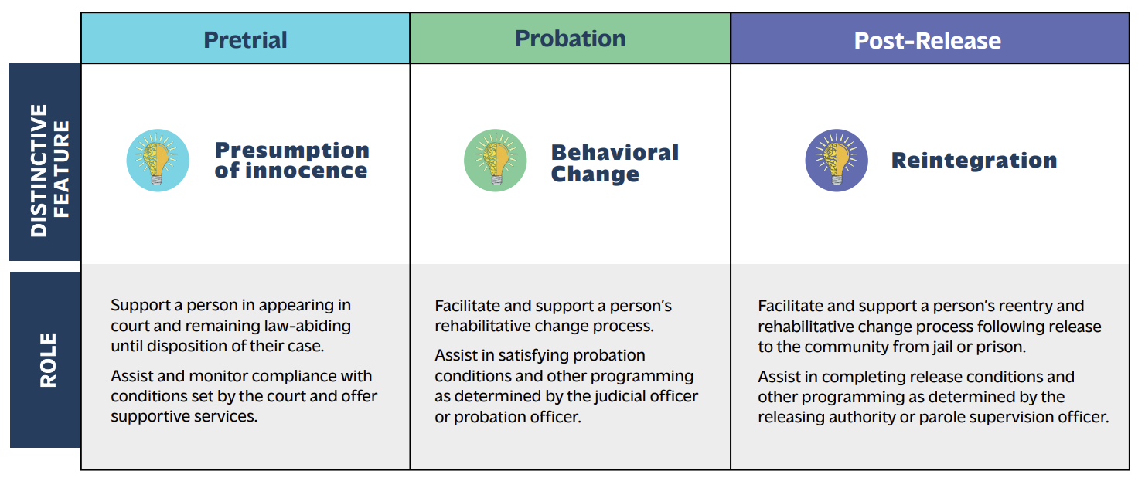
Roles and Responsibilities
Notes:
Tanya
These are very generalized, not inclusive of the many roles and responsibilities that you may serve in your respective capacities. Every jurisdiction has a different expectation in how they relate to the court.

Slide 37
Intake Process
Process | Pretrial | Probation | Post Release
Review court order
Risk and needs assessment
Develop case plan
Determine supervision level
Conditions of supervision
Develop rapport
Court reminders
Notes:
Both; Tanya lead - Elevate JPC
Alright, lets have some interactive fun and talk through the intake process and who’s role and responsibility is it. Please put your answers in the chat as
we walk through this

Slide 38
Assessment to Service Delivery
Compare and Contrast

Slide 39
Use of Assessment Tools
Pretrial
Measures the likelihood of appearing in court and staying law-abiding during the pretrial stage.
Generally used to help the court set release conditions and identify people who need the most support.
Probation and Post-Release
Measures the risk of recidivism (usually 3 to 5 years) and criminogenic needs.
Generally used to inform a person’s supervision level.
Assists in identifying targeted case plan interventions.
Notes:
Denise
Totally different tools
Should not be used in place of the other. They should be used with the population for which the tool was validated.
Professional judgment is important when exercised in conjunction with a validated assessment tool.
For example, the LSIR should not be used for Pretrial, and the PSA or pretrial assessment should not be used with a person on probation (unless they have a new pending criminal charge).

Slide 40
Assessment to Service Delivery
Pretrial
Determine the likelihood of success.
Assign to an appropriate supervision level.
Support to ensure needs are met, court appearance, and remain arrest-free.
Notes:
Tanya
Research tells us that pretrial monitoring is most effective for those who are least likely to succeed
When you support them, you need to identify their barriers to being successful. This means talking to them, getting to know them. Not just making sure their address is current.
Individualize your support: maybe they need bus passes, access to a food pantry, access to clothes, assistance with employment, or assistance with housing.

Slide 41
Assessment to Service Delivery
Probation/Post-Release
Determine needs and risk.
Assign to an appropriate supervision level.
Develop a strengths-based case plan; focus on reducing risk.
Prioritize needs and utilize cognitive-based programs.
Notes:
Denise
Similarly, probation is most impactful with moderate to higher-risk populations; with a focus on cognitive-behavioral programming.
Low-risk individuals tend to self-correct, yet probation tends to over-supervise these individuals.
Rely on the assessment to not only guide the level of supervision but also inform your case plan Your assessment tool should identify criminogenic needs that you should be referring to when developing your case plan.
The combination of assessment and case planning should inform your service delivery approach.

Slide 42
Service Delivery
Supportive Services
(Pretrial)
Supervision
(Probation and Post-Release)
Court date notifications
Check-ins with pretrial services staff
Childcare services to attend court appearances
Bus passes to attend court
Offer service referrals
Court ordered condition(s)
Prioritize program referrals based on the top 5 criminogenic needs
Incorporate skill practice activities
Incentivize behavior change (positive feedback/rewards)
Notes:
Both of us
Pretrial service delivery (or supportive services) is focused on ensuring the person appears in court and assisting a person who is motivated to change their
behavior, by referring them to a community-based service provider. Failure to complete treatment should not be an automatic reason for a return to custody.
Behavior Change is a process – won’t happen because a pretrial or probation officer tells someone to change.
Change will come through skill practice activities and incentivizing the motivation for change.
Like most things, a person is not likely going to be successful the first time in treatment.

Slide 43
Responding to Compliant and Non-Compliant Behaviors
Behavior Response

Slide 44
Responding to Compliant and Non-Compliant Behavior
Notes:
Tanya
Responding to compliant and non-compliant behavior is another important function of supervision.

Slide 45
Why is this Important?
Probation and Post-Release
Pretrial
Promote success
Prevent unnecessary detention
Build rapport
Promote success
Reduce recidivism
Encourage compliance
Build rapport
Encourage change
We have to help
people be
successful
Notes:
Tanya
This is important because it encourages compliant behavior and promotes success, which will prevent unnecessary detention. But most importantly, how you respond can either build rapport or negatively impact your rapport with the individual. Be authentic and transparent about your practices for responding to compliant and non-compliant behavior.

Slide 46
Managing Behavior to Promote Success
Identify compliant and non-compliant behavior.
1
Identify different responses for each behavior.
2
Match positive behavior to an appropriate incentive.
Match severity of non-compliant behavior to an appropriate response.
3
Notes:
Denise
It is essential to identify and articulate agency expectations surrounding responses to compliance and non-compliance. This should not be a one-size-fits-all approach.
Use of a matrix to identify different responses to behavior is a best practice.
While this allows for professional judgment, a matrix provides consistency and greater equality between staff in responding to behaviors.
Ensure staff and identified stakeholders are trained on agency expectations.

Slide 47
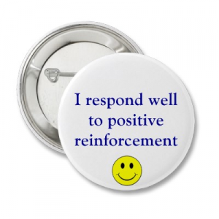
Responding to Compliance
Every interaction with an individual on pretrial, probation or post-release supervision is an opportunity to reduce harm.
Notes:
Denise
Responding to compliance and pro-social behaviors is just as important as responding to non-compliance.
Effective behavioral intervention strategies with individuals require reinforcements to outnumber sanctions by at least a 4:1 ratio; 5:1 is even better in reducing recidivism.*
*See Gendreau & Goggin, 1996; Gendreau, Little, & Goggin, 1996; Andrews & Bonta, 2006
This means being purposeful and meaningful.
Purposeful: intentionally finding things where you can offer positive feedback. (e.g., being on time for appts, completing a program, honesty)
Meaningful: what is meaningful to one person might be very different for another. Talk about what is meaningful. Doesn’t have to be costly - Your only limit is your creativity.
Essential to role model the changes you want to see.

Slide 48
Polling Question
Does your agency have an expectation or policy
supporting response to compliant behavior?
Notes:
Denise
Complete this poll question: What does your agency offer to support positive behaviors?
Verbal praise
Reduce supervision
Early Discharge
Convert in-person appointment to a phone appointment
Reduce or stop drug testing
Certificates
Letter of encouragement from an agent or supervisor
Bus tickets or other tangible reinforcements

Slide 49
Polling Question
Does your agency have an expectation or
policy supporting a response to non-
compliant behavior?
Notes:
Tanya
Please place your answer in the chat. Who would like to share one example?

Slide 50
Responding to Non-Compliance
Use a violation response matrix.
Understand that relapse is part of the change process.
Don’t ignore non-compliant behavior but respond to an issue at the lowest possible level.
Responses to non-compliance do not need to be harsh to be effective.
Don’t overload individuals with expectations that they can’t possibly meet successfully.
Notes:
Tanya
To be clear, the need to respond to non-compliance is important. However, we should never overreact or underreact to non-compliance, AND, responses to non-
compliance need to be timely and consider impact to public safety.
The use of behavior response matrices are a best practice. It allows you to individualize the response based on the severity of the action. This way your response is not over reactive and more importantly your agencies responses will be consistent amongst you and your colleagues.

Slide 51
Levels of Non-Compliance
Levels of Non-Compliance
Infractions | Moderate Violation | Severe Violation
Generally, it involves violations that show a lapse in judgment and do not cause harm to others. | Violations that appear to show a disregard for court orders and probation or pretrial supervision but did not cause harm or potential harm to others. | Violations that appear to show a willful and/or repeated disregard for court orders, probation supervision, pretrial supervision, and/or violations which cause or present a risk of harm to the client or others.
Notes:
Tanya
This is applicable to both pretrial and probation. If your agency is using a matrices, it will differentiate between levels of severity and appropriate
responses based on that severity. This is important for continuity amongst staff.

Slide 52
Ensuring a Solid Foundation
Values, Vision, and Mission

Slide 53
Vision, Mission, and Values
Effective teams articulate their vision, mission, and values to establish a clear direction and focus for achieving their desired results.
Notes:
Denise
After leaving here today, we would encourage you to review and discuss among your team whether or not your Values, Vision, and Mission statements reflect the similarities and differences we have offered today.

Slide 54
Values (Examples)
Human Dignity
Collaboration
Compassion
Equity
Fairness
Integrity
Consistency
Respect
Public Safety
Notes:
Denise
List in the chat some of the core values of your agency. Are they in writing?
Values drive the vision and infuse the mission; and describe the standards of conduct by which actions and decisions are rendered.
Values also tend to reflect the culture and attitudes of your organization.

Slide 55
Vision (Examples)
“We envision a pretrial system in Sonoma County that protects the public, ensures the rights of defendants, and relies on fair, efficient, and risk-based pretrial decision-making.”
–Sonoma County Pretrial, CA
“To enhance public safety by having incarcerated persons return home, under supportive supervision, less likely to revert to criminal behavior.”
–State Department of Corrections and Community Supervision, NY
Notes:
Denise:
A vision is a statement of a preferred future or desired end-state.
It describes what your team aspires to achieve. A vision helps your team understand where it is going or what it aims to accomplish.
It should be short, to the point, and memorable.

Slide 56
Mission (Examples)
“Assist in the administration of justice and promote community safety by ensuring fairness and equality in the pretrial process.”
–Illinois Office of Statewide Pretrial Services (OSPS)
“We are dedicated to a safer Orange County through positive change.”
–Orange County Probation, CA
Notes:
Denise
A mission describes who you are and what you do as a team.
It often describes the actions that can be taken to move in the direction of your team’s vision.
While there are often many similarities in the values of pretrial, probation, and post-release agencies, the vision and mission statements should be different because they have different purposes.
When you go back to your work setting, take some time to review your vision and mission statements – are your agency values reflected in these statements? When were they last updated? How often are they discussed within your agency?

Slide 57
Data-Driven Decision-Making
Compare and Contrast

Slide 58
Measuring for Success
Notes:
Tanya
We’ve talked about roles, responsibilities, service delivery, use of assessment tools, responding to compliance and non-compliance, and now lets talks about the importance of measuring for success.
Share story about being an officer needing to do statistics, if time permits!

Slide 59
Importance of Performance Measurements
An objective way to account for activities and accomplishments over time.
A method to quantify the cost/benefit of investments and allocate additional resources or reallocate resources
An opportunity to identify and intervene with implementation problems (or potential problems) that can impede goal achievement
Objective and specific data can be used to report performance to staff and system stakeholders
Osborne, D. and Gaebler, T. (1992) Reinventing Government: How the Entrepreneurial Spirit Is Transforming the Public Sector. Addison-Wesley, Reading.
Notes:
Denise
So, in other words: (read)
Adapted from: Osborne & Gaebler, 1992
If results are not measured, successes cannot be distinguished from failures.
If successes cannot be distinguished, they cannot be acknowledged and rewarded, or learned from.
If failures cannot be identified, they can’t be corrected.
If results cannot be demonstrated, support cannot be secured
It’s important for transparency that you are sharing your performance measurements with staff and the community.

Slide 60
How to Evaluate Pretrial Success?
To what extent does the condition/intervention help to maximize pretrial release/liberty (by not leading to detention)?
To what extent does the condition/intervention help to maximize court appearance?
To what extent does the condition/intervention help to maximize law-abiding behavior/community safety?
Notes:
Tanya
Talking points:
The best way to evaluate for pretrial success is to look at the conditions effectiveness and how it holds up to the 3m’s. Data helps you have those important conversations with system stakeholders.

Slide 61
How to Evaluate Probation and Post-Release Success?
To what extent does the condition/intervention help to rehabilitate the person?
To what extent does the condition/intervention help to hold the person accountable?
To what extent does the condition/intervention help to reduce recidivism?
Notes:
Denise
List in the chat what your agency currently measures.
These are common performance measurements among probation agencies:
Rehabilitation – successful discharges
Accountability – responses to compliance and non-compliance
Recidivism Reduction – the definition varies by state, so this is not something you can use for cross-comparison.

Slide 62
Example of Pretrial Performance Measurements
To what extent are people released on pretrial reappearing in court? (Failure to appear rate)
To what extent are people released pretrial remaining arrest-free? (New criminal arrest rate)
To what extent are people released pretrial receiving technical violations and statutory violations?
Notes:
Tanya
Tracking technical vs statutory is really important because if the person is reappearing in court and remaining arrest free,but receiving technical violations. Has the system set them up for failure? Are they being over conditioned? Are your departmental policies structured so that they are focused on managing failure instead of promoting success.

Slide 63
Example of Probation and Post-Release Performance Measurements
Recidivism
Responses to compliance and non-compliance
Payment toward restitution
Program/treatment completions
Staff training in evidence-based practices
Staff coaching activities
Number of persons on supervision
Overrides to the assessment information
Notes:
Denise
These are also other common areas probation often uses to track performance.

Slide 64
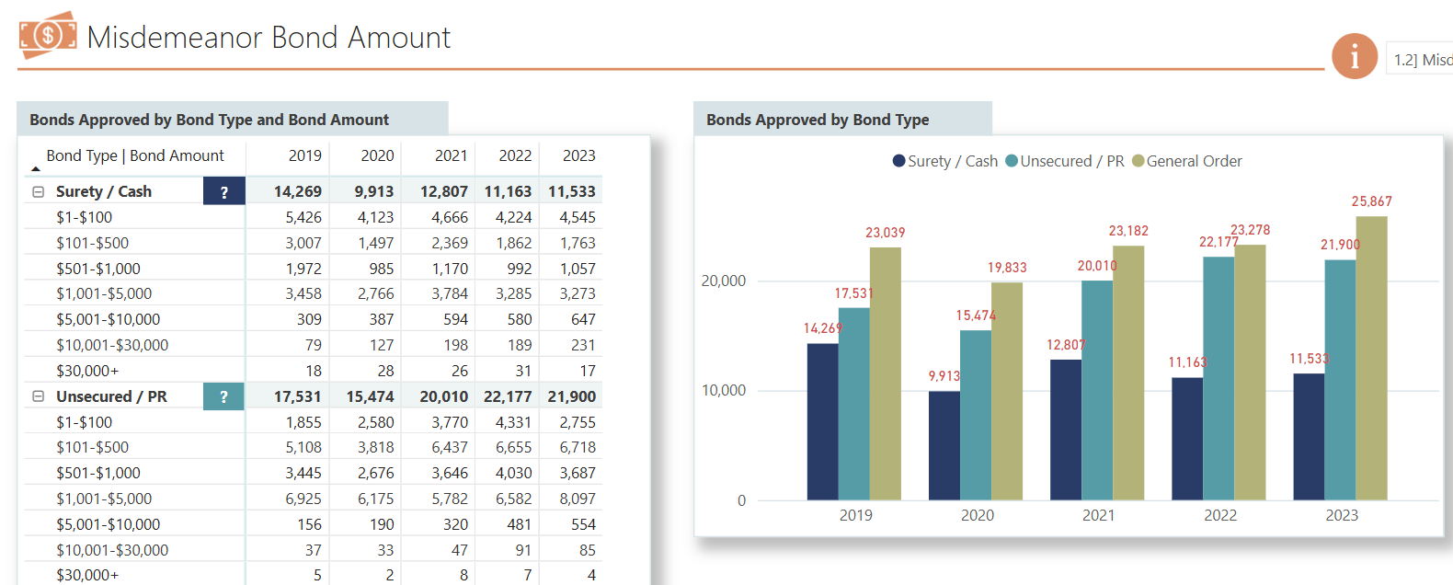
Example of Pretrial Data Dashboard
Harris County Office of Justice and Safety > Data (harriscountytx.gov)
Notes:
Denise: Put Link in the Chat
Two links Sam will add to the chat which are examples of data dashboards in pretrial and probation.

Slide 65
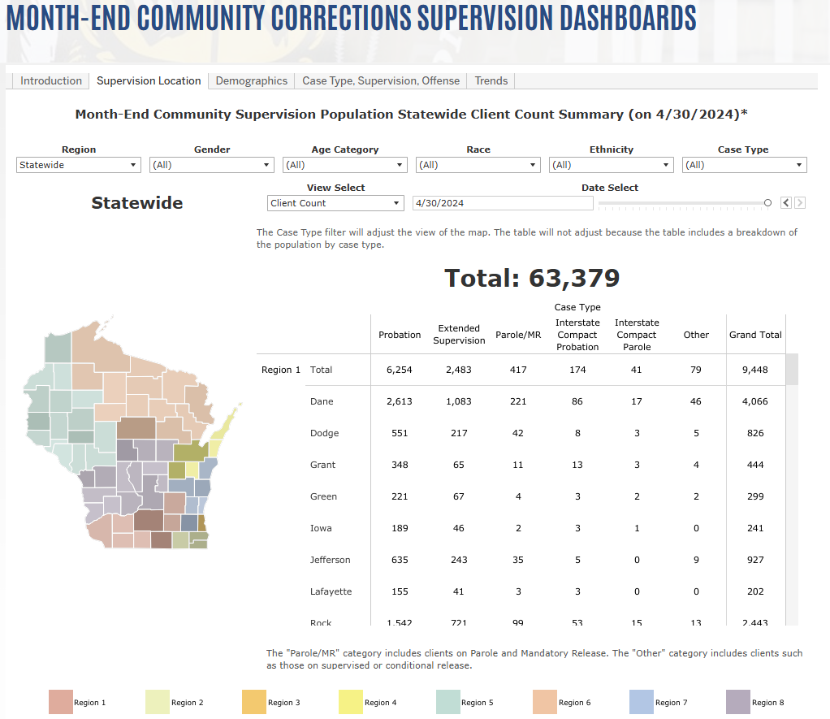
Example of Probation and Post-Release Data Dashboards
https://doc.wi.gov/Pages/DataResearch/InteractiveDashboards.aspx
Notes:
Denise: Put link into the chat
Data dashboards ought to be individualized to your location/agency; these are just examples.

Slide 66
Recap
Pretrial, probation and post-release share many similarities, but they differ in how they supervise individuals and in their outcome expectations.
Behavior response is essential to successful supervision outcomes. Ensure you are achieving at least a 4:1 ratio of affirmation to sanctions.
Values, vision, and mission matter. They inform staff and the community about what you are trying to accomplish.
Performance measurements matter. You can’t manage what you don’t measure!
Promote success instead of managing failure!
Notes:
Tanya

Slide 67
Every Interaction is an Opportunity to Reduce Harm!
Notes:
Tanya

Slide 68
Evaluation and Questions
Tanya Anderson
tanderson@cepp.com
Michael Beltran
Justice Policy Consultant
michaelb@bailproject.org
Denise Symdon
dsymdon@cepp.com
Notes:
Troy

Slide 69
Community Supervision Resource Center
Visit communitysupervisioncenter.org to register for upcoming CSRC webinars:
Post-conviction Risk Assessments (Sep 26)
Employee Peer Support Programs (Oct 16)
Supervision in Rural Communities (Nov)
Desistance from Crime (Dec)
Notes:
Troy

Slide 70
Notes:
Troy

